Slide 1
SBU REPORTING FOR
FINANCE
Training

Slide 2
Introduction
SBU Reporting for Finance Security Administrators:
Sara Lehmann
Sara.Lehmann@Stonybroook.edu
632-6029
Michael Danielson
Michael.Danielson@Stonybrook.edu
632-1890

Slide 3
What is SBU Reporting for Finance?
SBU Reporting for Finance is a reporting tool that allows users to run various financial reports in an ALL FUNDS manner.

Slide 4
How is SBU Reporting Different?
A one stop source for financial reports
Without it, users need to go to various sources:
  SUNY BI - STATE and IFR Accounts
  AES Reports (within ERAS) - STATE and IFR Accounts
  RF Report Center - RF Accounts
  ERAS - SBF Accounts
  FSA Report Distributions - FSA Accounts

Slide 5
SBU Reporting is a Versatile Tool
Ability to set Report Parameters such as:
  By Business Units
  By Funds
  By Organizational Level
Drill Down Capability
Export Capability
  Export to Excel
  Export to PDF

Slide 6
How Current is the Data?
State/IFR Data is 3 Days old
SBF Data is as of Yesterday
FSA Data is as of Yesterday
RF Data is loaded on a monthly basis
  Keep these in mind when running month-end reports

Slide 7
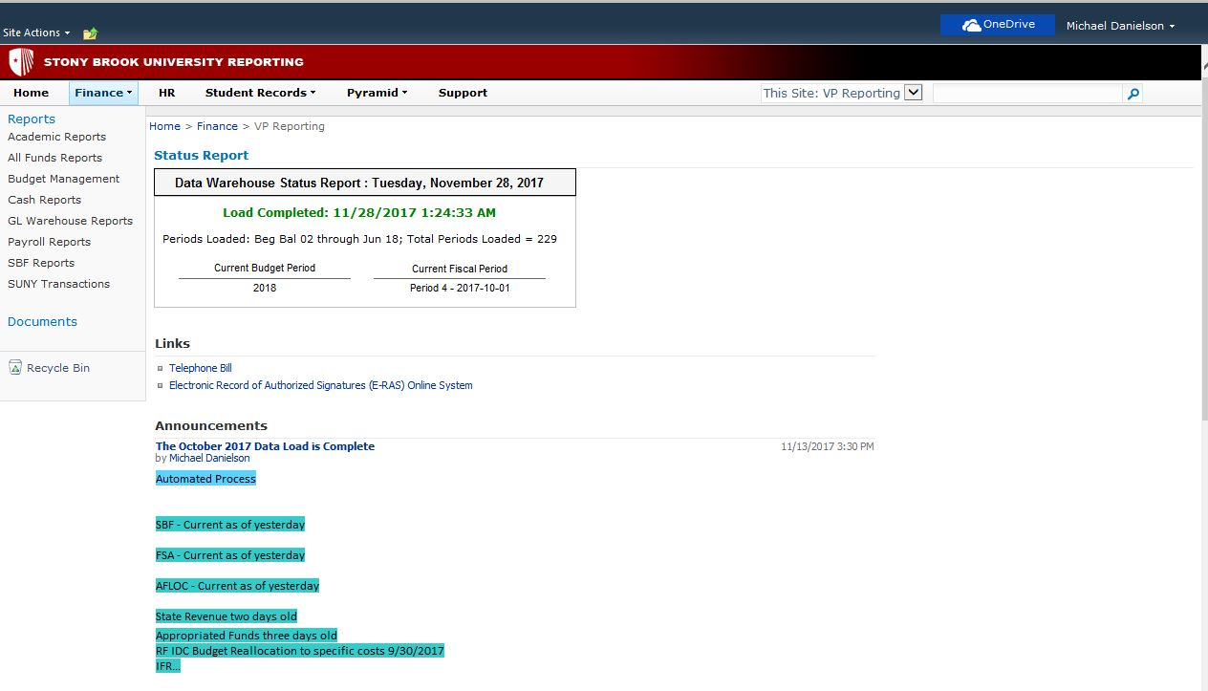
Check the Announcements Page!

Slide 8
What accounts do I have access to?
You will only see those accounts you have been approved access for
Security for most users is copied from SUNY BI security
Account managers and Report Recipients on SBF accounts will see accounts in SBU Reporting

Slide 9
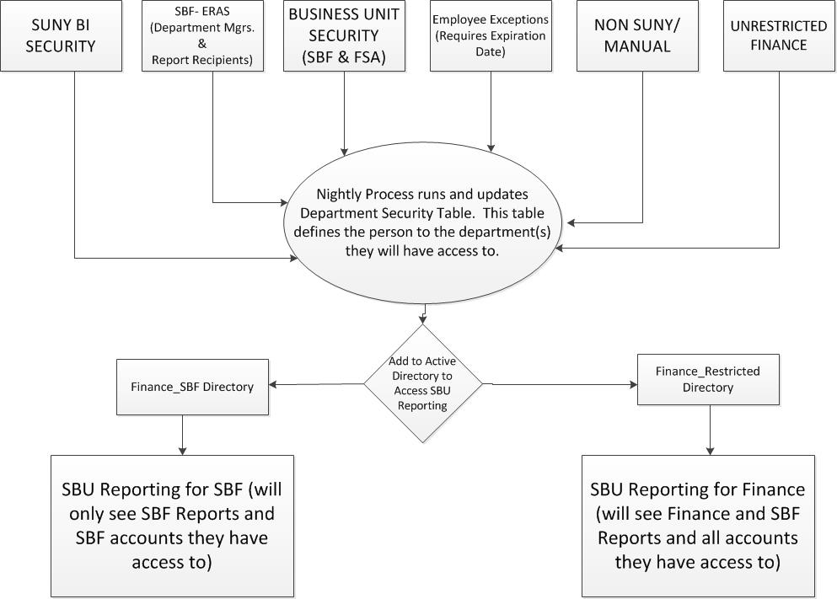

Slide 10
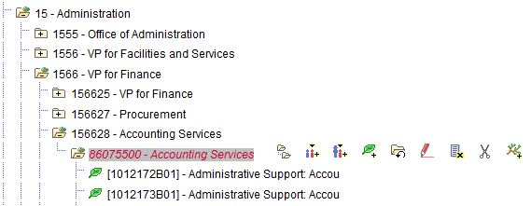
Example of Org Level Security
If a user has access to 1566% (VP For Finance), they will see all State/ RF accounts that roll beneath the org level
If they have been approved business unit security for SBF/FSA they will see all those accounts that roll up to the org level as well
A user will also see any SBF accounts they are an Account Manager or Report Recipient on, regardless of the org rollup

Slide 11
Signing in to SBU Reporting
User ID is sunysb.edu\ “NetID”
Password is your NetID password
Some users over at HSC may default to “UHMC”. This should be removed and replaced with “sunysb.edu\”

