Slide 1
SPONSORSHIPS AND BRAND PARTNERSHIPS WORKING GROUP: ​ Executive Summary - April 2021 Optimizing Campus Cultural, Athletic & Facilities Resources ​

Slide 2
Sponsorships Proposal
Initiative Type: Revenue enhancer related to establishment of brand partnerships with companies
Problem Statement: Stony Brook is not capitalizing on opportunities to generate revenue through strategic partnerships with local and national businesses.
Opportunity: Create a new sponsorships function that will work with campus units in addition to stakeholders like faculty and staff to build revenue-generating relationships with local and national businesses.

Slide 3
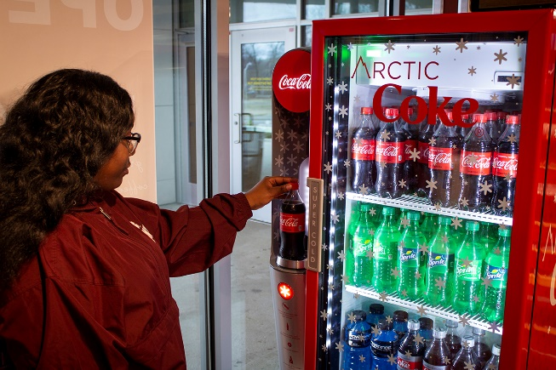
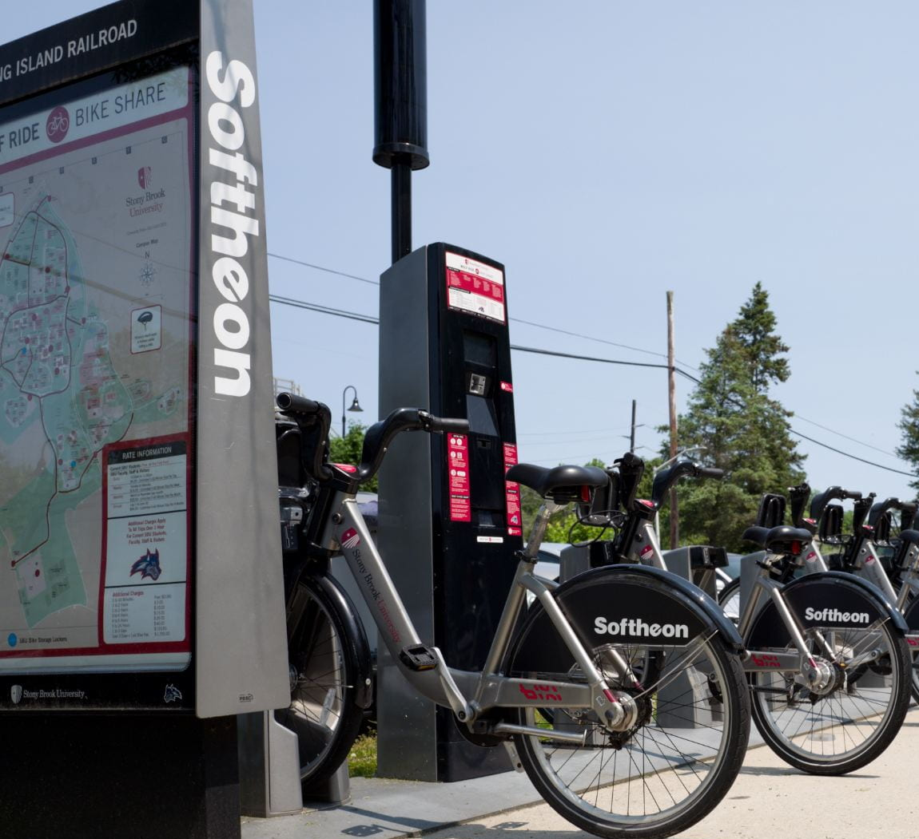
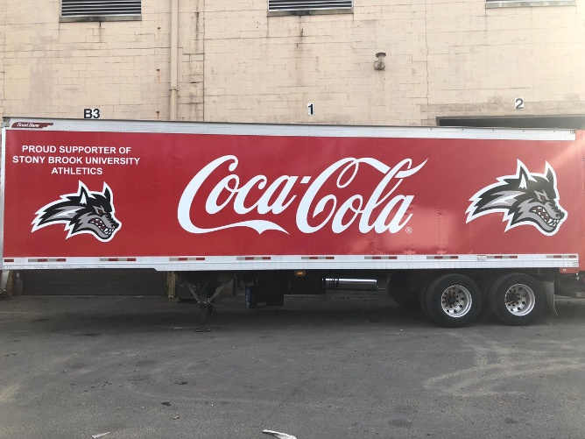
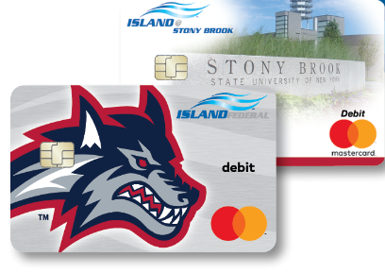
Current State: Existing Sponsorships
Softheon Wolf Ride Bike Share Program
Coca Cola Pouring Rights Agreement
$9.6M in value over 10 years
Island Federal Credit Union $7M over 10 years

Slide 4
Why Sponsorships?
Sponsorships by the Numbers
14
Number of Universities Interviewed
<50
Number of Institutions with Sponsorship Offices
$14.2M
Revenue Generated by UC Berkeley Sponsorships Office
“It’s really difficult to reach these young consumers nowadays…They don’t watch television. They don’t have cable. They’re not reading magazines. A lot of them don’t have a car, so they’re not seeing billboards. If you’re able to get on campus and reach them in a nonthreatening environment where they might be more predisposed to be marketed to, that’s a huge win.”
Jonathan Jensen, PhD Assistant Professor, Sport Administration University of North Carolina at Chapel Hill

Slide 5
Implementation Considerations
Organization Model: Determine whether function should live in Advancement, Finance & Administration, or Office of the VP for Strategic Initiatives. Recommendation to establish it in the OVPSI with cross-divisional standing committee.
Revenue Sharing: Determine optimal revenue sharing agreement with campus units participating in sponsorship execution. Recommendation to pass through 80-90% of contract revenue to relevant units.
Sponsorship Policy: Developing a transparent sponsorship policy is important—as Buffalo’s program states, the policy must “align with the university’s mission and core values, be free of obscene, indecent, or profane material, and comply with applicable local, state, and federal laws and regulations as well as university policies.”
Brand Categories and Exclusivity: Consider creating brand categories within which an exclusive partner is identified. Categories might include: Banking, Insurance, Energy, Automotive, Wireless, Water and Soft Drinks, Technology, Scientific, and Travel. There may be significant legal, policy, and business community-related implications related to any exclusive partnerships, so these risks must be balanced against the potential benefits.
Physical, Digital, and Event Asset Inventory: Collaborate across SBU to develop a list of high-visibility assets (e.g., New Student Orientation) available as part of sponsorship packages. High-profile events (e.g., Roth Regatta) are among the most coveted of activation opportunities for sponsors (USC focuses exclusively on them).

Slide 6
Cost/Benefit Information
Benefits:
Year One Revenue Projection of $350K, rising to $4M by Year Five
Reputational enhancement through increased corporate footprint
Entry point for corporations into SBU ecosystem (e.g., research partnerships, student recruitment, employee professional development)
Costs/Risks
Year 1 Total Expenses (2 FTEs + OTPS) of $316K, rising to $785K (3 FTEs + OTPS) by Year 5
Possibility that a corporate partner’s actions will conflict with our values, thus necessitating an intervention
Possibility of push back from student activists and faculty
Concerns from some campus units about inability to do independent sponsor cultivation
Ease of Implementation:
One year implementation timeline
Complex implementation needing campus buy-in and collaboration across many divisions

