Slide 1
The False Promise of Net Price as an Affordability Metric
Braden J. Hosch, Ph.D.
Asst. Vice President for Institutional Research, Planning & Effectiveness
North East Association for Institutional Research Annual Meeting
Philadelphia, PA
November 11, 2014

Slide 2
Overview
Except for institutions with very few commuters, net price is not a valid measure of affordability because cost of living budgets are determined without sufficient standards and consistency
Research partners:
Robert Kelchen, Seton Hall University
Sara Goldrick-Rab, Univ. of Wisconsin-Madison

Slide 3
Net Price and Cost of Attendance Calculations
Tuition
Required Fees
Books
Room & Board*
+ Other Costs
Cost of Attendance
Cost of Attendance
- Grant Aid
Net Price
* based on living arrangements

Slide 4
How Living Costs ARE Determined
Set in a manner “defined by the institution” (HEA)
Sparse guidance in FSA Handbook:
  periodic surveys of your student population,
  assessing local housing costs or other pertinent data
  otherwise reasonable methods
NASFAA Monograph

Slide 5
Living Costs As Share of COA

Slide 6
Application of Grant Aid To Costs
Grant aid is generally applied
First to offset direct costs (tuition and req. fees)
Then to offset books, supplies, living expenses
Residual net price after application of aid weights cost of living components even more as share of total COA

Slide 7
Net Price Uses
Federal Uses:
HEOA Watch Lists College Navigator
White House Score Card Rating System (?)
Selected Ranking Publications:
Washington Monthly
U.S. News Best Value Colleges
Kiplinger’s Best Value Colleges

Slide 8
Methodology
Generate county-level estimates of cost-of-living
Compare campus-reported costs for living expenses off-campus, not with family to county-level estimates
Results analyzed by sector and geospatially

Slide 9
REGIONAL ADJUSTMENT APPROACH (1)
Model approach on the MIT Living Wage Calculator (Glasmeier & Arete, 2014), using data available when 2013-14 COA numbers were developed
Adjusted for regional differences using 2013 County Cost of Living Index when needed
Room and board:
  Housing: HUD median rents by county for efficiency apartment without roommates (FY 2012)
  Food: USDA low-cost food plan (June 2012)

Slide 10
Regional Adjustment Approach (2)
“Other expenses”:
  Transportation: BLS Consumer Expenditure Survey for individuals under 25 years old (2012)
  Health care: Average premium by state from the Kaiser Family Foundation—national average used if missing data (2010)
  Miscellaneous: BLS Consumer Expenditure Survey for individuals under 25 years old (2012)

Slide 11
Institutional Data
Primary source: IPEDS IC 2013-14
Selection criteria:
Values reported both for
  Room & board, off-campus not with family
  Other expenses, off-campus not with family
Reporting status differences
  Academic year reporter values treated a 9 months
  Program reporters normalized to 9 months
Excluded institutions from U.S. Territories

Slide 12
Limitations
Costs are not uniform within counties
Urban areas: Gasoline/rent costs vary within small areas
Rural areas: Transportation costs vary by distance to college
Does not reflect variation in needs within students that can be captured by professional judgments

Slide 13
Overarching Findings
Higher cost estimates in urban/rural counties
Half of institutions in most expensive quartile of counties
Huge institutional variation at county level:
  56.4% of institutions within $3,000 of estimate
  10.8% of institutions $3,000+ above estimate
  32.8% of institutions $3,000+ below estimate

Slide 14
County-Level Estimates, 9 Months
 | Room & Board Costs |  |  | Other Costs |  |  |  | Total
 | Housing | Food | Total | Transp. | Health Care | Misc. | Total
Min | 2,862 | 1,665 | 4,572 | 2,061 | 1,224 | 621 | 4,077 | 9,126
25th pctile | 3,969 | 1,872 | 5,877 | 2,331 | 1,809 | 702 | 4,860 | 10,863
50th pctile | 4,662 | 1,944 | 6,606 | 2,421 | 1,890 | 729 | 5,040 | 11,678
75th pctile | 5,623 | 2,068 | 7,711 | 2,565 | 2,025 | 774 | 5,371 | 12,940
Max | 12,051 | 3,690 | 15,489 | 4,590 | 3,933 | 1,386 | 9,189 | 24,426
Mean | 5,040 | 2,003 | 7,039 | 2,490 | 1,990 | 753 | 5,233 | 12,272
SD | 1,572 | 214 | 1,719 | 266 | 457 | 80 | 682 | 2,213
Source: Kelchen, Hosch & Goldrick-Rab (2014). Table 3.

Slide 15
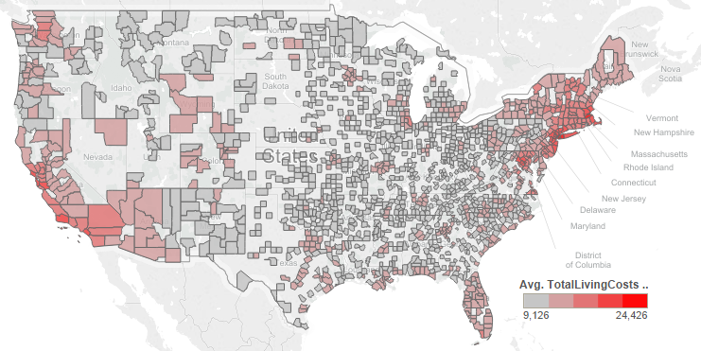
County-Level Estimates, 9 Months
Source: Kelchen, Hosch & Goldrick-Rab (2014). Table 3.

Slide 16
Estimated Living Costs by Region
Source: Kelchen, Hosch & Goldrick-Rab (2014). Table 2.

Slide 17
Reported Vs. Estimated Living Costs
Source: Kelchen, Hosch & Goldrick-Rab (2014). Table 4.

Slide 18
Milwaukee County
Source: Kelchen, Hosch & Goldrick-Rab (2014). Table 5.

Slide 19
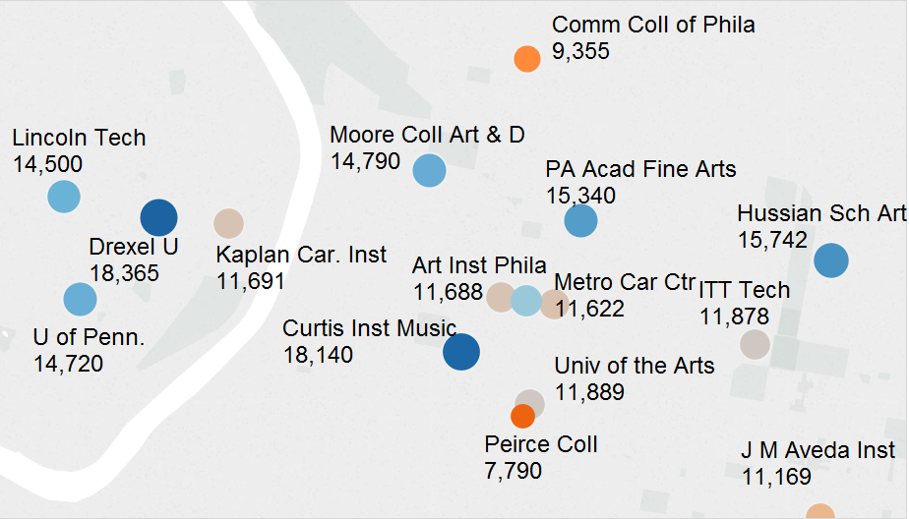
Living Costs, 9 Months Philadelphia (Detail)
Institutionally reported costs off campus, not with family

Slide 20
Milwaukee County

Slide 21
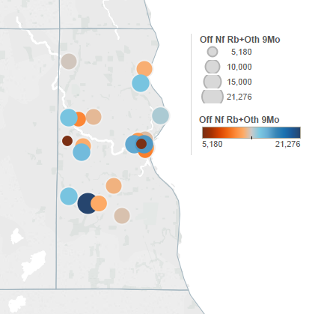
Living Costs
Milwaukee County, Wisconsin

Slide 22
Washington, DC
* No reported data

Slide 23
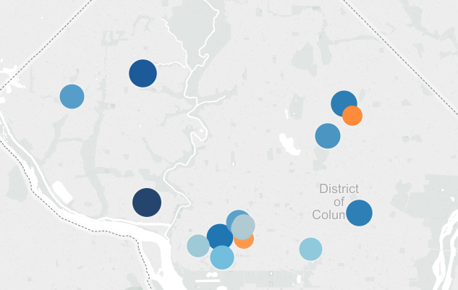
Living Costs Washington, DC

Slide 24
Implications
Net price statistics for institutions with sizeable commuter populations are not necessarily valid across groups
  Net price should not be used for accountability broad groups of institutions without correction for living costs
  Benchmarking activities should examine variation in COA budgets prior to examination of net price

Slide 25
Unintended Consequences
Manipulation of net price to game accountability
Subverts transparency agenda
Artificial lowering of living costs
Incentives to lower living cost budgets may stress students who qualify for less aid

Slide 26
On-Campus Living Costs by Year

Slide 27
OFF-Campus Living Costs by Year

Slide 28
Recommendations (1)
Determine living costs at federal level with regional (county) adjustments
Failing federal determination, authorize ED to establish rigorous methodology for cost of living budgets
Do not include net price in ratings system or 3rd party rankings, unless statistically adjusted

Slide 29
Recommendations (2)
IR professionals should examine living costs in their area, identify reported costs of local institutions, and assist in budget construction
Conduct more research on living expenses at different geographic scales, esp. health care
Research community should take more active role in examining reliability and validity of prominent educational statistics

Slide 30
Resources & Contact Info
Kelchen, R., Hosch, B., Goldrick-Rab, S. The Costs of College Attendance: Trends, Variation, and Accuracy in Institutional Living Cost Allowances. Association of Public Policy and Management (2014). http://wihopelab.com/publications/.
http://www.stonybrook.edu/commcms/irpe/reports/
Braden.Hosch@stonybrook.edu

