Slide 1
Unlock
Student Success
With
Brightspace
Learning Analytics

Slide 2
AGENDA
Introductions
What is Learning Analytics?
Accessing and Understanding Brightspace Data
Turning Data into Actionable Insights
Q&A
2

Slide 3
ABOUT US
DIANA VOSS Director of Academic Technology Service Division of Information Technology
ADAM G. PILIPSHEN Assistant Director of Assessment, Evaluation, and Research Division of Student Affairs – CRAFT Team
Confidential & Proprietary |
3

Slide 4
HOW ABOUT YOU?
What do you hope to learn from this presentation?
Confidential & Proprietary |
4

Slide 5
Learning Analytics
noun
Learning analytics is the measurement, collection, analysis, and reporting of data about learners and their contexts, for purposes of understanding and optimizing learning and the environments in which it occurs.
Confidential & Proprietary |
5

Slide 6
KEY BRIGHTSPACE DATA & INSIGHTS
Course Overview Widget (more info)
Course Content Statistics (more info)
Discussion Statistics (more info)
Rubric Statistics (more info)
Quiz Statistics (more info)
course access, overall class performance, aggregated discussion activity
# of students accessing materials, # of visits per material, time spent viewing materials, average time spent per topic
# of posts created, # of posts read, # of posts replied to, popular/trending discussion topics
overall score statistics, average score per criterion, distribution of scores, distribution of scores per criterion, percentage of students at each achievement level
overall quiz statistics (e.g., standard deviation,# of attempts, average time to complete, question performance (e.g., discrimination index, point biserial)

Slide 7
WHY USE LEARNING ANALYTICS? Data-Driven Instruction
Enhance Student Engagement
Identify struggling learners and tailor interventions based on engagement patterns (e.g., content access, participation).
Deepen Content Comprehension
Pinpoint knowledge gaps and adjust instruction to address specific areas where students struggle.
Targeted Communication
Provide personalized feedback and support based on individual student performance and needs.
Optimize Course Design AND DELIVERY
Refine teaching strategies, materials, structure, and content based on student performance data, engagement trends, historical data, and interaction patterns.
Formative Assessment Integration
Utilize data from practice activities to inform instruction and prepare students for future learning.
Research & Scholarship
Explore learning trends and the effectiveness of different teaching strategies using aggregated data.

Slide 8
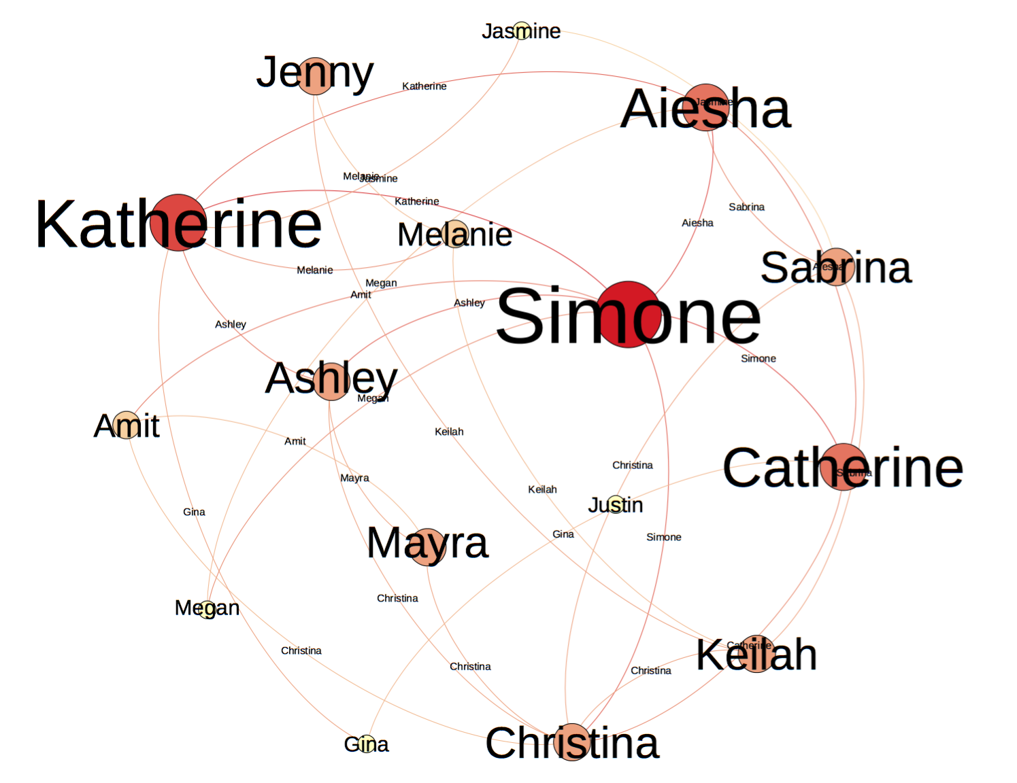
Q&A
8

Slide 9
THANK YOU
ADDITIONAL QUESTIONS? PLEASE CONTACT: DIANA VOSS Director of Academic Technology Service Division of Information Technology
diana.voss@stonybrook.edu
ADAM G. PILIPSHEN Assistant Director of Assessment, Evaluation, and Research Division of Student Affairs – CRAFT Team
adam.pilipshen@stonybrook.edu
Center for Excellence in Learning and Teaching
celt@stonybrook.edu

