Slide 1
Publicly Available Data Sources for Academic Program Selection
Presented by Dan Pitti

Slide 2
Why data matters in academic program selection
Students need to be able to make informed choices about the academic program they will enroll in.
Publicly available data also helps administrators, faculty, and staff evaluate program effectiveness, align curriculum with labor market demands, enhance career advising, and guide strategic planning to improve student outcomes and institutional performance.
Notes:
Students need to be able to make informed choices about the academic program they will enroll in, based on ROI, Retention Rates, and potential Career Outcomes.

Slide 3
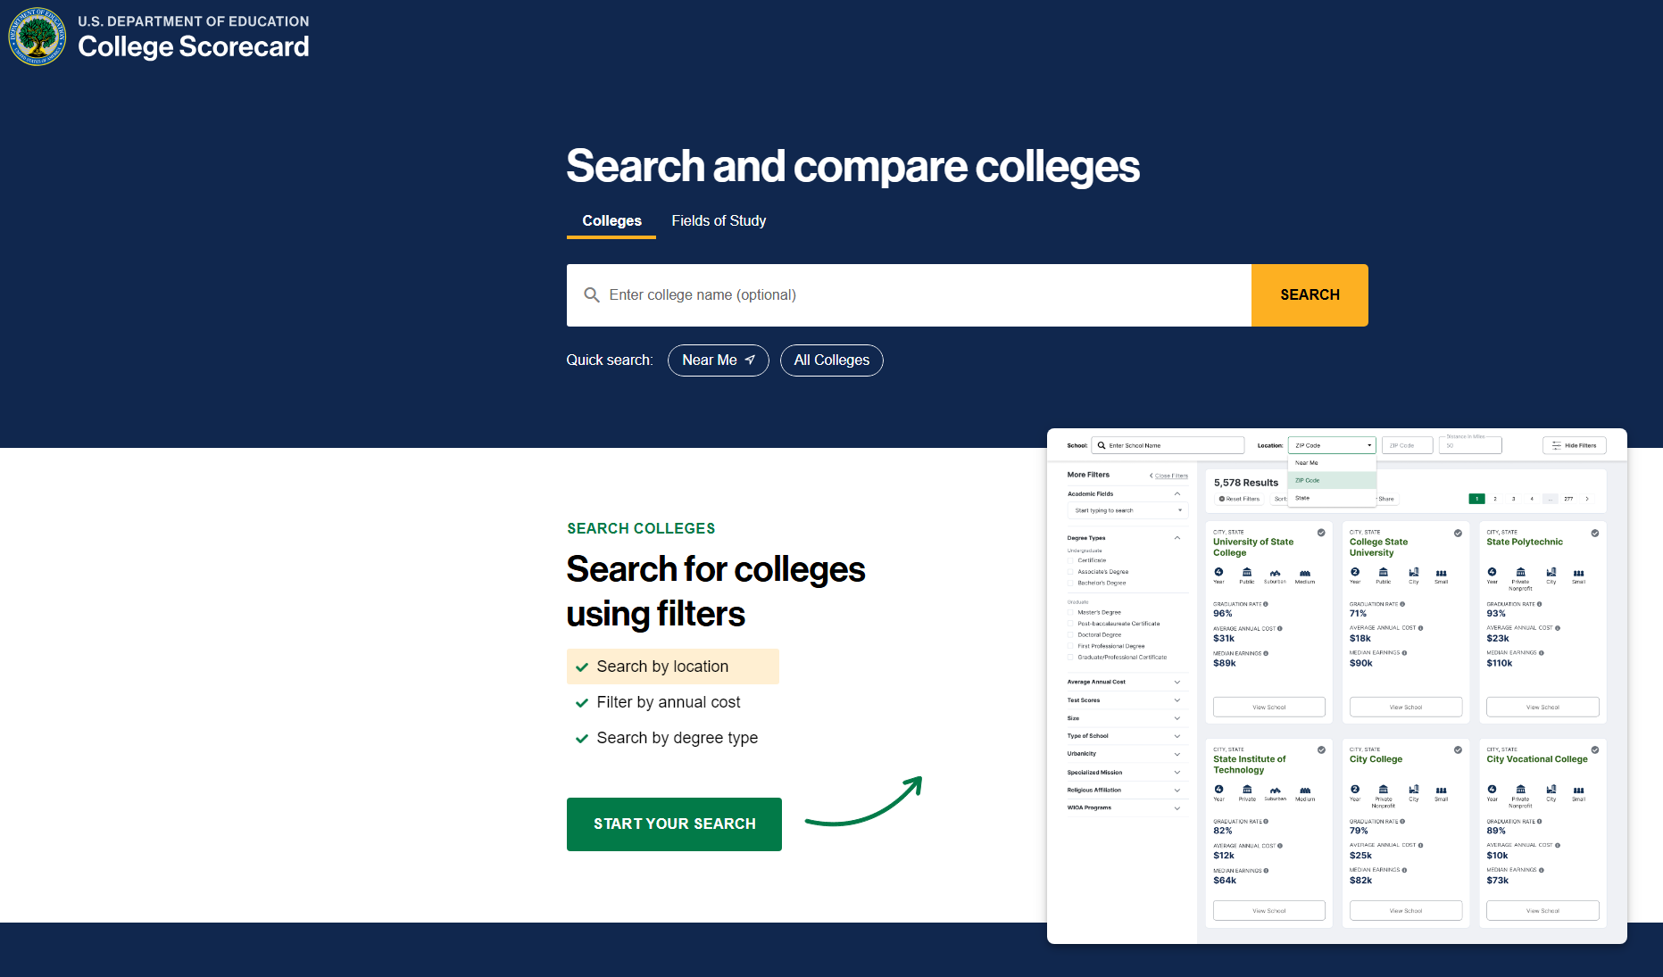
U.S. Department of Education College Scorecard
Very simple and intuitive tool. Stakeholders can compare specific programs at individual schools.
Median Earnings, Student Debt, and Program Size are available for many schools.
Side-By-Side Comparison feature to aid in decision making.
Reliable data
General
Notes:
https://collegescorecard.ed.gov/
Data is sourced from IPEDS (Integrated Post-Secondary Education Data System) and NSLDS (National Student Loan Data System)

Slide 4
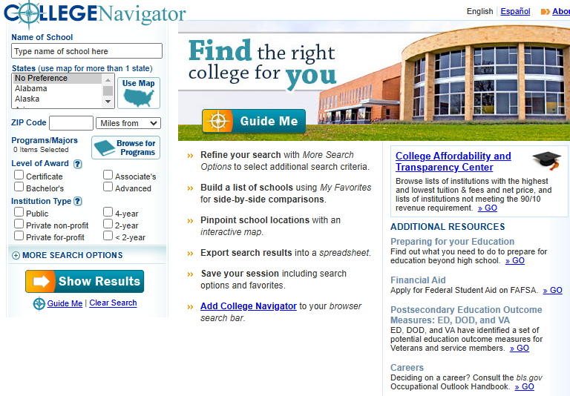
NCES College Navigator
Detailed information on nearly 7,000 U.S. Post-secondary institutions.
Stakeholders can find data on programs offered, retention and graduation rates, cost of tuition and other expenses, available financial aid, degrees awarded, campus safety, and accreditation, among others.
Export & Save features for future reference.
Notes:
https://nces.ed.gov/collegenavigator/

Slide 5
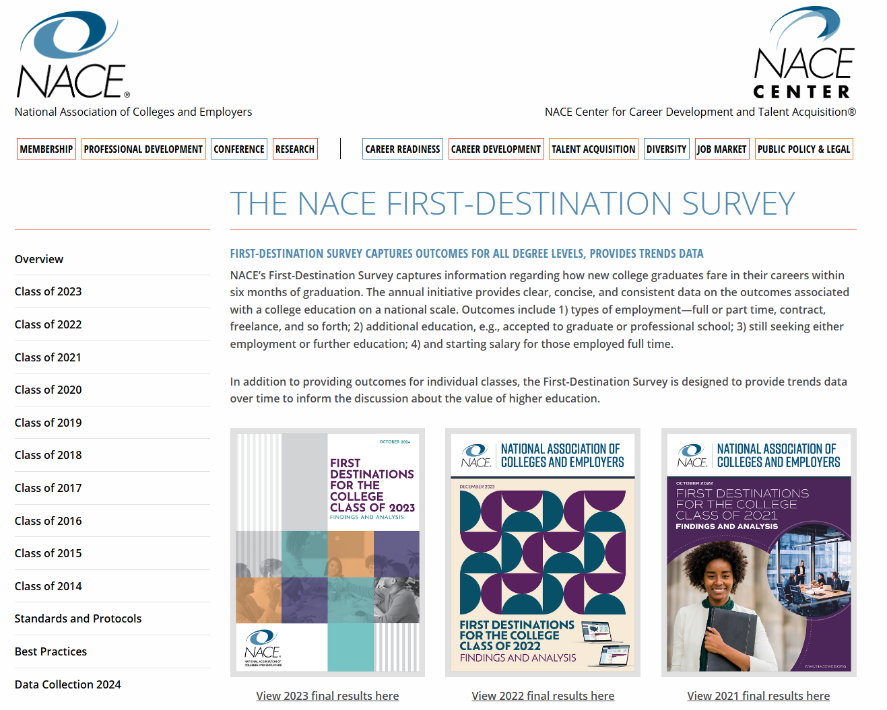
National Association of Colleges and Employers (NACE) First Destination Survey
Collects data on the post-graduation outcomes of new college graduates within six months, including employment types, further education, and starting salaries.
Offers annual reports and dashboards detailing outcomes by degree level, academic program, and demographics, aiding stakeholders in assessing the value of higher education.
Notes:
https://naceweb.org/job-market/graduate-outcomes/first-destination/

Slide 6
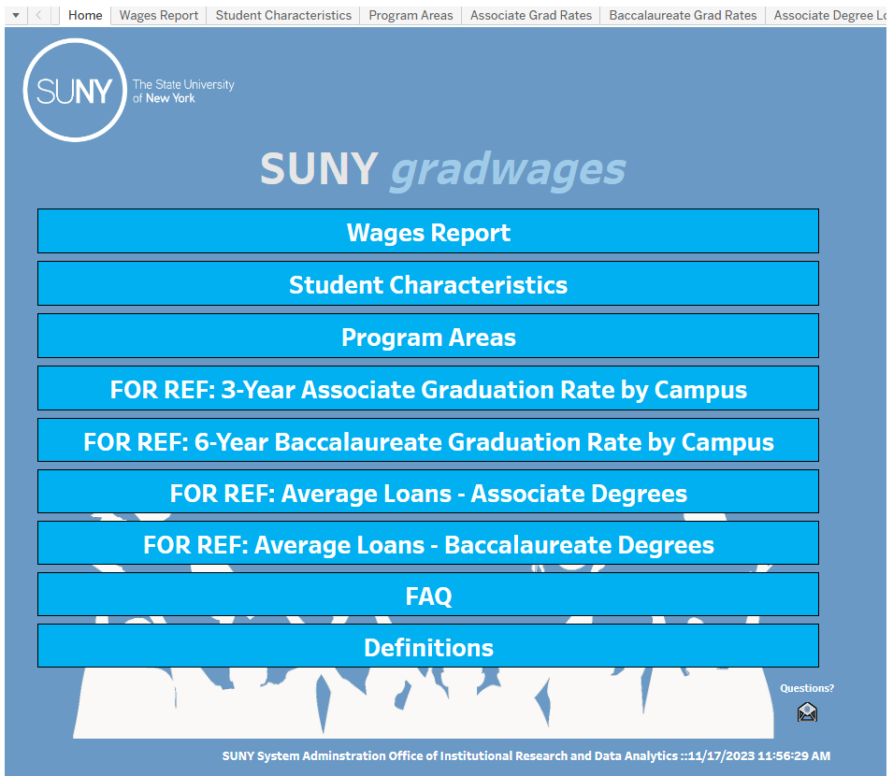
SUNY Graduate Wage Data
Provides interactive dashboards displaying median wages of SUNY graduates, by program and campus, from 1 to 10 years post-graduation.
Combines SUNY academic records with NYS Department of Labor wage data.
Stakeholders can sort by field of study, degree type, and campus.
Notes:
https://www.suny.edu/gradwages/

Slide 7
Best Practices for Using Data
Reported career outcomes are not the only thing that matters: Factor in cost of living, industry demand, and regional employment trends to avoid misleading conclusions.
Use wage and employment data to highlight programs needing improvement or areas with strong growth potential for new offerings.
Regularly review data to inform curriculum updates, resource allocation, and strategic planning for long-term program success.

Slide 8
Thank you!

